Slide 1
Here are five different colors of card stock for you to use in making your name tags.
Our group division will be based on the color you choose.
Within each group, 2–3 students will form a discussion unit and will take turns serving as the small-group discussion leader in each discussion session (Starting from Week 3）.
When we need to do some in-class group discussion activities, they will happen with in the five large groups.
So… go ahead and pick your card stock!

Slide 2
1. Introduction & Ice breakers
Breakout Sessions
POLS 1101
12:40pm-1:30pm Park Hall 145
& 1:50pm-2:40pm Leconte Hall 135
SIYUAN (Siri) ZHAO
Siri.Zhao@uga.edu

Slide 3
About me
Siyuan (Siri) Zhao, first-year PhD student of PADP
  You are my first group of students!
Research Interests: Citizen-state interactions, Public Personnel Management, Organizational Behavior
Got BA & MA at Peking University (PKU), China
Learn with you, Learn from you
  Leader: Professional
  Companion: New in America!

Slide 4
Course Overview
This course is designed to introduce students to the institutions and processes of American national government and Georgia.
Breakout sessions account for 10% of your overall grade in the class.
Your grade for breakout sessions will depend on you showing up and participating in discussions and activities.
Part 1: Ideas and Values as the Foundation of Politics
Political Values
Democracy
Constitutional Foundations
Federalism & Georgia politics
Part 2: Political Actors & Processes
Civil Liberties, Civil Rights
Congress
Presidency
Bureaucracy
Courts
Interest Groups and Pluralism
Political Parties
Mass Media
Part 3: Political Behavior
Public Opinion
Participation & Voting
Campaigns & Elections

Slide 5
Classroom Policies & Expectations
Attendance is REQUIRED
  2 Opportunities for valid absence (No reason needed)
  After that, you should contact me via email in advance (at least 1 hour before class), showing me a formal document, such as a medical certificate or a letter from the relevant authority
  In case of an emergency, documentation may be submitted afterwards.
  Attendance will be recorded starting NEXT WEEK!
Class Participation Expectations
  Be Prepared – Complete all assigned readings or materials before class.
  Contribute Actively – Share your thoughts, ask questions, and respond to others in a respectful and constructive manner
  Listen Respectfully – Give full attention to the speaker, and acknowledge others’ ideas. Be mindful of those who have another kind of life and hold a different viewpoint from you!
    I am open to interruptions, while you should consider whether the group discussion leader (seen later) welcomes it.
  Express freely – This is a time where we will be openly discussing sometimes controversial topics. Facing the “politics outside the classroom”, you‘re allowed to freely express your opinions and thoughts, based on what you’ve learned in this course (lecture & discussion sessions)
  Stay Relevant – Keep comments and questions focused on the topic under discussion.

Slide 6
Classroom Policies & Expectations (cont`d)
Use of Electronic Devices
  Laptops, tablets, and mobile phones are permitted in class only for purposes directly related to the course, such as taking notes, accessing course materials, or participating in class activities.
  For any non-class use, including messaging, browsing social media, or unrelated web surfing: Not allowed UNLESS you persuade me how it is connected to class ☺
Academic Integrity
  Completing your own group work, properly citing all sources, and refraining from any form of plagiarism, cheating, or unauthorized collaboration
Communication & Feedback
  Contact: Siri.Zhao@uga.edu
  Students are encouraged to communicate openly with the instructor regarding course content, assignments, or any concerns. I will do my best to respond to emails within 24–48 hours on weekdays.
  Constructive feedback on the course is always welcome, and opportunities will be provided throughout the semester for you to share your suggestions, making the discussion session as well as my teaching better!

Slide 7
Self Introduction
1 minute for each one – you can choose some of these questions to answer, or express anything letting us know more about “who you are”
General Info
Name (Preferred names and pronouns), year, major
Have you taken any related courses before?
Is there a political or social issue you care about most?
Expectations for this course
What do you hope to learn or achieve in this course?
Are there any particular topics you’re looking forward to discussing?
What skills do you hope to develop through our discussion sessions?

Slide 8
Structure of Future Breakout Sessions
Presentation given by small-group discussion leaders (10-15 minutes)
  12 Weeks in total. A 2-student and a 3-student small group for those with 5 students; three 2-student groups for those with 6 students (2*3+3*2=12)
  Summarize, comment on, and critique the assigned readings
  Propose 1–3 question(s) worth discussing with the whole class
Class discussion (in large groups)
  Discuss the above questions (or any other questions you believe important and relevant to what we learn/read that week) within your group. (5-10 minutes)
  Each group selects one member to present in turn. While a group is presenting, members of other groups may raise questions or challenge their points. (15-20 minutes)
  Try to rotate the presenting member each session, though this is not mandatory.
A short review given by TA (5-15 minutes)
  In the discussion session before each exam, we will devote more time to review and a Q&A session, and shorten the earlier activities accordingly.

Slide 9
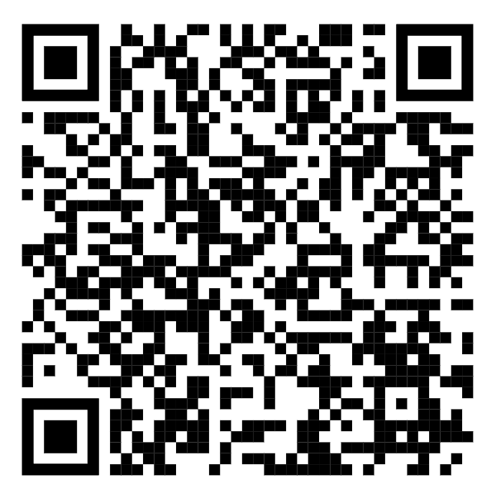
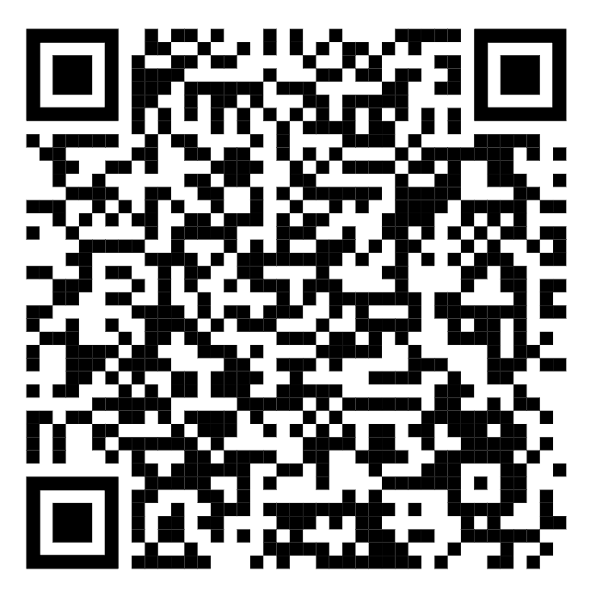
Due:
Next Friday (Aug 22th),
23:59
12:40 Park Hall
1:50 LeConte Hall
In accordance with FERPA, participation in shared documents is voluntary. You may use an alias or request to remain anonymous in public materials.
But REMEMBER: Put something (e.g. a code name, a number, …) into the e-form, or the time you prefer to give a presentation will be occupied by others. If you do not use your real name, please let me know who you are via email.
Notes:
By the end of next week’s discussion session, anyone who is still not in a small group will be assigned by me.

Slide 10
Next week…
We’ll have no group discussion leaders!
Read materials on Political Values and Democracy before class, and we will discuss in large groups
If anyone wishes to alter your group, please find someone who agrees to switch with you, and both of you should contact me at the same time.
ENJOY YOUR WEEKEND!

